Slide 1
TASTE BUDS – RECIPES
A Social Media platform for foodies, food content creators
And chief community
TEAM
APPALA.DEEPAK
ATLA VAMSI
R.MADHUMIDAA
HEMA N
Batch 11

Slide 2
PROBLEM STATEMENT
Improved cooking skills: By providing detailed instructions and ingredient lists, users can learn new cooking techniques, explore new flavors, and improve their culinary skills.
Personalization: Users can create and manage their own recipe posts, allowing them to personalize their cooking and share their unique recipes with others.
Revenue generation: The website has the potential to generate revenue through advertising or sponsored content, which can help support the website’s continued development and maintenance.

Slide 3
OBJECTIVES
Provide a platform for users to share and discover new recipes from around the world.
Encourage user engagement and community building by allowing users to like, dislike, and comment on recipe posts.
Increase user retention by providing a user-friendly interface and allowing users to easily create, edit, and delete their own posts.
Facilitate recipe searching and browsing by allowing users to filter by category and view posts sorted by popularity.

Slide 4
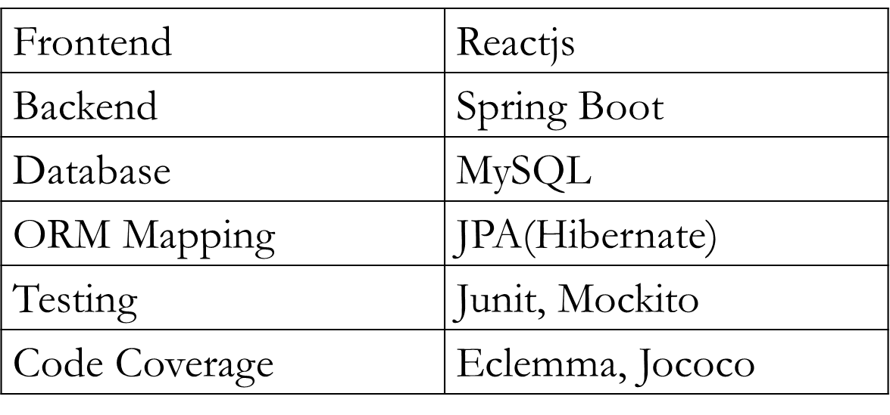






Technology Stack

Slide 5
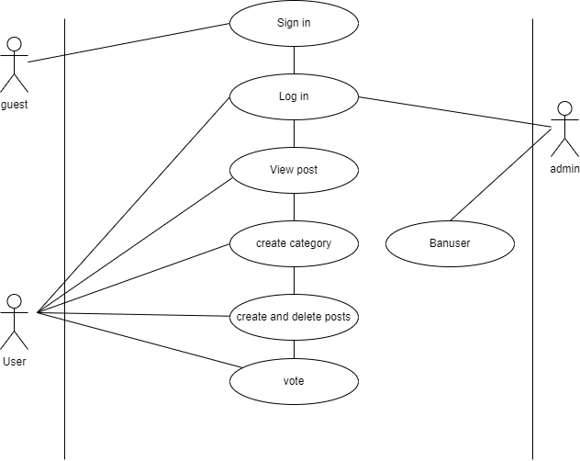
Use-Case Diagram

Slide 6
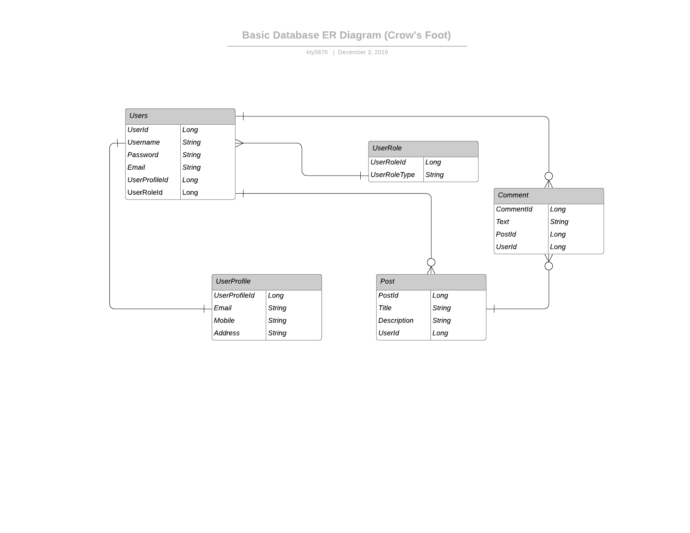
Entity-Relationship Diagram

Slide 7
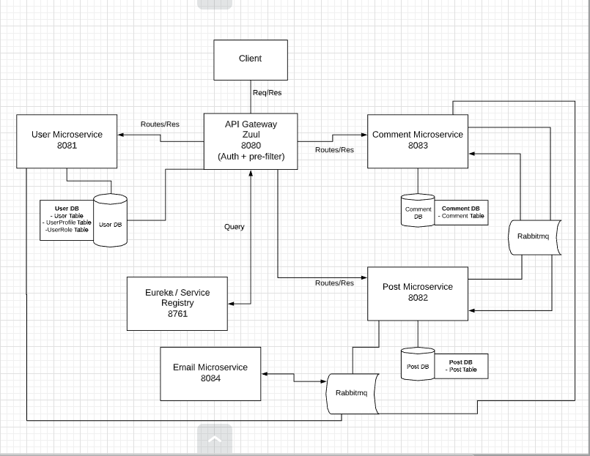
Our architechcher model

Slide 8
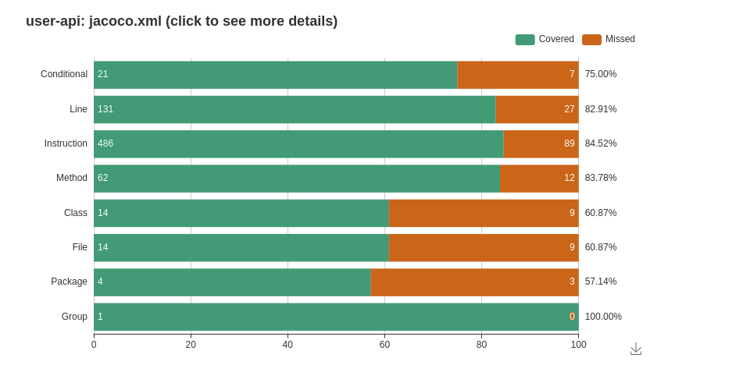
Tests and code coverage

Slide 9
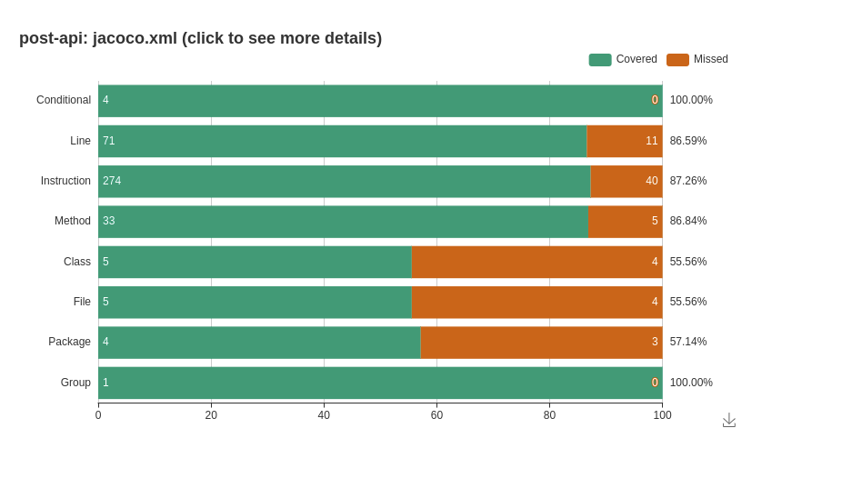
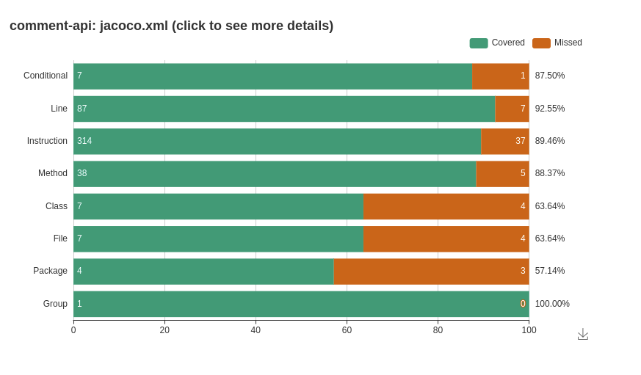

Slide 10
conclusion
Backend:
For backend we have built 3 primary microservices and 3 featuring microservices
In conclusion the backend Supports user have a user profile and will be able post and comment on the posts
Frontend :
For frontend we made interactive ,dynamical web page using react
We have user login ,post and comment in the frontend

Slide 11
thank YOU

